Slide 1
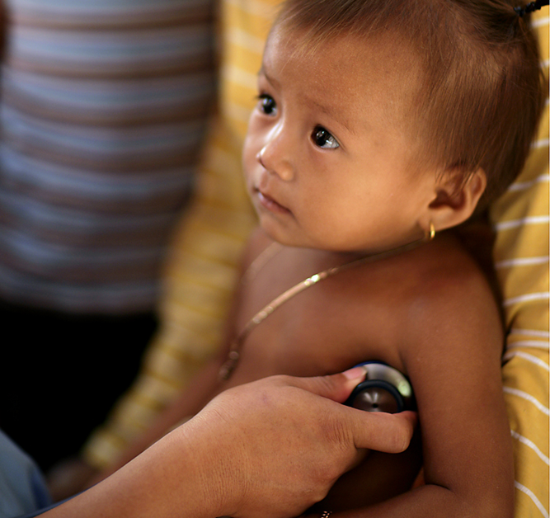
Clinical Characterisation Protocol
Training for Site Staff
CCP Global Toolkit Step 3 Training for Site Staff, Version 2, 10th August 2021 [Based on the WHO/ISARIC Clinical Characterisation Protocol (CCP), Version 3.1/3.2; Citation: Dunning, J. W., et al. (2014). "Open source clinical science for emerging infections." Lancet Infect Dis 14(1): 8-9].
Licensed under a Creative Commons Attribution-ShareAlike 4.0 International by ISARIC on behalf of Oxford University. Please credit us in any publication or dissemination of documents/training.

Slide 2
Notes on this presentation
Guidance/suggested wording is provided in [blue text] and should be modified before the final presentation is given to any staff members
CCP Global Toolkit Step 3 Training for Site Staff, Version 2, 10th August 2021

Slide 3

Background
A novel coronavirus-induced disease was identified in Wuhan, China (COVID-19)
[Consider providing a description in the context of local / country level]
Symptoms vary from none to severe pneumonia in a minority
This is an observational study, using data collected routinely as a part of clinical care
For the collection of data and biological samples in a globally harmonised manner
CCP Global Toolkit Step 3 Training for Site Staff, Version 2, 10th August 2021

Slide 4
Overview of the Protocol
Inclusion Criteria
Children and adults with suspected or confirmed novel Coronavirus (COVID-19) infection
Data Collection (Tier 0 to Tier 3)
ISARIC/WHO COVID-19 Case Report Form (paper CRF or web-based electronic “eCRF”) to be completed e.g. the COVID-19 Core CRF, or the RAPID CRF
Depending on local resources, interest and feasibility, chose which tier to use
Sites are encouraged to enter data using the eCRF(s)
Tier 0
Patient data (CRF)
Sampling (Tier 1 to Tier 3)
Read the Clinical Characterisation Protocol to make an assessment to decide if you have the resources and capacity to do: Sampling on enrolment (Tier 1) and / or Serial Sampling (Tier 2 or 3)
Tier 1
Patient data (CRF)
Single Biological Sample
Tier 2
Patient data (CRF)
Serial Biological Sampling
Tier 3
Patient data (CRF)
Population Pharmacokinetics of antimicrobials & immune modulators
CCP Global Toolkit Step 3 Training for Site Staff, Version 2, 10th August 2021

Slide 5
Aims of the study (1/2)
Primary objectives
Describe the clinical features of COVID-19 and identify risk factors
Describe, where appropriate, the response to treatment, including supportive care and novel therapeutics
[In addition, depending whether you are operating to Tiers 1, 2, 3 - please delete as appropriate]
Observe, where appropriate and feasible, pathogen replication, excretion and evolution, within the host, and identify determinants of severity and transmission using high-throughput sequencing of pathogen genomes obtained from respiratory tract, blood, urine, stool, CSF and other samples
Characterise, where appropriate and feasible, the host responses to infection and therapy over time, including innate and acquired immune responses, circulating levels of immune signalling molecules and gene expression profiling in peripheral blood
Identify host genetic variants associated with disease progression or severity
Understand transmissibility and the probabilities of different clinical outcomes following exposure and infection
CCP Global Toolkit Step 3 Training for Site Staff, Version 2, 10th August 2021

Slide 6
Aims of the study (2/2)
Secondary objectives
Facilitate effective triage and clinical management of patients with COVID-19
Develop clinical guidance documents and offer clinical recommendations to policy makers on the basis of evidence obtained
[In addition, depending whether you are operating to Tiers 1, 2, 3 - please delete as appropriate]
Determine infectivity and inform appropriate infection control measures of the various pathogens
CCP Global Toolkit Step 3 Training for Site Staff, Version 2, 10th August 2021

Slide 7


Eligibility
All adult and children with proven or suspected COVID-19, admitted to hospital should be considered for the study
Participants should be enrolled assuming
All eligibility criteria are met; and
Patient or their guardian etc. has given their consent to participate in the study [Note: consent may not be required for Tier 0, Data Collection only]
All documents available in the Study Master File, found [provide details of location]
CCP Global Toolkit Step 3 Training for Site Staff, Version 2, 10th August 2021

Slide 8

The Patients Journey (1/2)
[Details about a 'dedicated isolation room', for treating, consenting, samples collection etc.]
CCP Global Toolkit Step 3 Training for Site Staff, Version 2, 10th August 2021

Slide 9

The Patients Journey (2/2) continued…
Safety points e.g. PPE is available at facility
Online training materials for PPE use:
UK National Health Service:
https://www.youtube.com/watch?time_continue=2&v=kKz_vNGsNhc&feature=emb_title
Public Health England:
https://www.gov.uk/government/publications/wuhan-novel-coronavirus-infection-prevention-and-control/covid-19-personal-protective-equipment-ppe
World Health Organization:
https://apps.who.int/iris/bitstream/handle/10665/331695/WHO-2019-nCov-IPC_PPE_use-2020.3-eng.pdf
OPEN WHO, COVID-19: How to put on and remove personal protective equipment (PPE):
https://openwho.org/courses/IPC-PPE-EN
Centers for Disease Control and Prevention:
https://www.cdc.gov/coronavirus/2019-ncov/hcp/using-ppe.html

Slide 10
Screening & Study Enrolment; Participant Information Sheet (1/3)
The patient, or the patient’s carer/guardian, should be provided with a ‘Participant Information Sheet’ and allowed to read and ask any questions
Ensure that the patient, or the patient’s carer/guardian, has had time to ask any questions (they may be scared)
They must understand that participation is voluntary – they can stop at any time, and request that any samples or information collected can be destroyed
If they do not enter the study they understand that it will not affect they way that they doctors will treat them – they still receive the best care currently available
All information about the patient will be kept private. Only the people responsible for their care and for this study will know that they were involved in this study
No personal details i.e. name, date of birth etc. are collected
Their data will be stored [on a computer/in a filing cabinet], and will be kept secure. [Provide details on the duration that the data will be kept]
CCP Global Toolkit Step 3 Training for Site Staff, Version 2, 10th August 2021

Slide 11
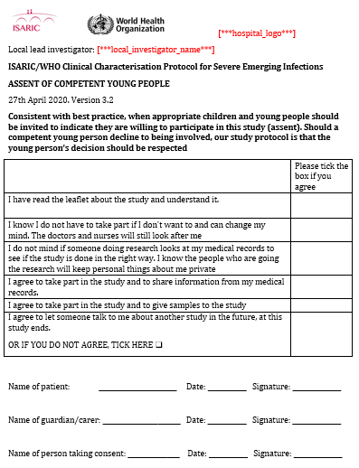
Screening & Study Enrolment; Informed Consent Form (2/3)
[Insert picture of an example consent form]
If they are willing then they should complete the Informed Consent Form and either sign, or provide a thumbprint where requested
If participant can give consent, but is unable to read, then a witness countersigns the form to indicate that the consent process was informed
Some patients will be too ill to give informed consent
In this situation, provide Participant Information Sheet to legal representative (e.g. close relative, friend or doctor not involved in the study)
Person receiving consent should complete their section as indicated on the form
CCP Global Toolkit Step 3 Training for Site Staff, Version 2, 10th August 2021

Slide 12
Screening & Study Enrolment; Children, (3/3)
Children <12 years of age should be provided with the ‘younger’ children information leaflet and this should be read along with their parent(s)/carer/guardian
The parent/guardian should sign the consent form (or provide a thumbprint)
Children aged 12-16 years of age should be provided with the relevant information sheet and the child given the opportunity to sign the information sheet (or provide a thumbprint) to indicate their assent if they are well enough and signature is possible
The parent / guardian should sign (or provide a thumbprint on) the consent form (witnessed consent)
Young people aged >16 years should be provided with the ‘adult’ information sheet and they should sign (or provide a thumbprint on) the consent form (or witnessed consent used)
[Witnessed consent may be obtained over the if hospital visiting rules or parental infection mean a parent/guardian cannot be physically present]
CCP Global Toolkit Step 3 Training for Site Staff, Version 2, 10th August 2021

Slide 13
Screening & Study Enrolment; Sampling
Laboratories and samples (skip if working to Tier 0 only)
[Outline laboratory biosafety procedures and the appropriate BSL2, BSL3 or BSL4 safety management and guidelines (dependent on local/national guidelines)]
[Outline the procedures for serial sampling, including the appropriate timings of serial samples, depending on the locally adapted protocol (Tiers 2 or 3)]
[Outline the procedures for biological sample processing involving manual techniques and/or use of laboratory equipment, depending on the locally adapted protocol]
[Provide an outline/overview of sample processing, including sample handling and labelling]
CCP Global Toolkit Step 3 Training for Site Staff, Version 2, 10th August 2021

Slide 14
Completion of Data Collection Forms
[Describe how to complete the data collection form; if you are using the ISARIC tools – there are two forms to chose from, and a link to the guidelines are provided below]
Core CRF completion guide:
https://isaric.org/research/covid-19-clinical-research-resources/covid-19-ccp-global/
Rapid CRF completion guide:
https://isaric.org/research/covid-19-clinical-research-resources/covid-19-ccp-global/
CCP Global Toolkit Step 3 Training for Site Staff, Version 2, 10th August 2021

Slide 15
Entering data using the eCRF
[If you are using the ISARIC Data Platform – there are two eCRFs, the Core and the Rapid; Links to the data entry guides are provided below]
Core CRF completion guide:
https://isaric.org/research/covid-19-clinical-research-resources/covid-19-ccp-global/
Rapid CRF completion guide:
https://isaric.org/research/covid-19-clinical-research-resources/covid-19-ccp-global/

Slide 16
Thank you
Please contact [name and contact details of the Principal Investigator]
CCP Global Toolkit Step 3 Training for Site Staff, Version 2, 10th August 2021

Slide 17
CCP Global Toolkit Step 3 Training for Site Staff, Version 2, 10th August 2021

